Slide 1
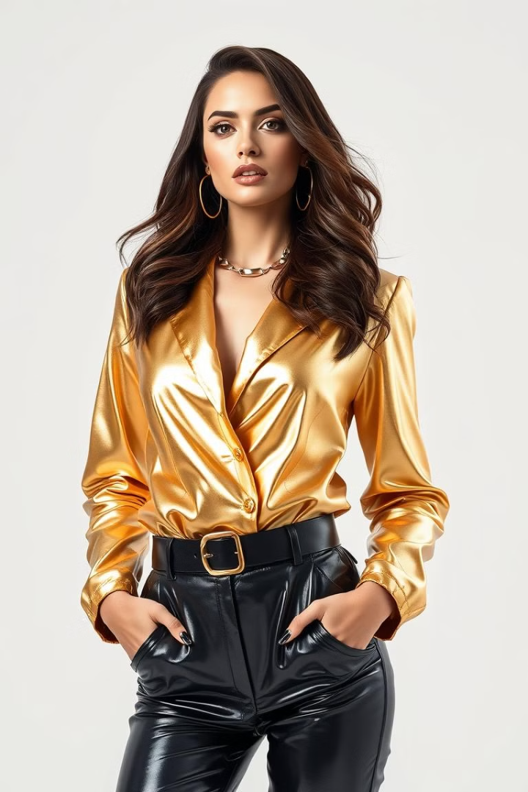
Fashion Recommender System with ResNet50
This fashion recommendation system utilizes the powerful ResNet50 convolutional neural network to extract visual features from fashion images, enabling similarity-based recommendations to help shoppers discover new styles they'll love.

Slide 2

Deep Learning for Visual Feature Extraction
1
CNNs for Feature Extraction
2
Global Max Pooling Layer:
The code uses ResNet50, a model known for its strong performance in image recognition tasks, as a feature extractor by removing its fully connected layers (include_top=False). This approach has been widely adopted in visual recommendation systems, as CNNs can extract high-dimensional feature representations that capture the visual semantics of images.
The addition of a GlobalMaxPooling2D layer after the ResNet50 model reduces the feature map to a lower-dimensional vector, helping to simplify the feature representation. Such pooling operations help retain only the most significant features, improving computational efficiency without significantly compromising accuracy.

Slide 3
CNNs for Feature Extraction
Convolutional Layers
Pooling Layers
Learn local visual patterns like edges, textures, and shapes that are relevant for fashion.
Progressively extract higher-level features by downsampling and aggregating information.

Slide 4
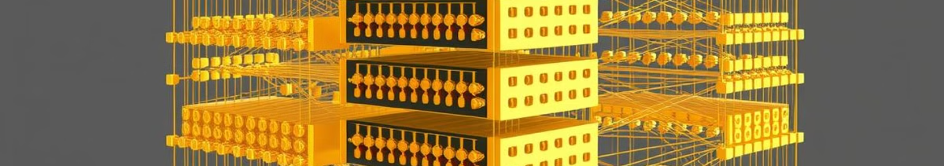
ResNet50: Architecture and Advantages
Residual Connections
Performance on ImageNet
ResNet50 uses skip connections to mitigate the vanishing gradient problem, enabling very deep models.
ResNet50 achieves state-of-the-art results on the ImageNet benchmark, making it a powerful feature extractor.
Efficient Inference
Transfer Learning
The model's compact size and optimized architecture enable fast, real-time feature extraction.
The pre-trained weights can be fine-tuned for various fashion-related computer vision tasks.

Slide 5
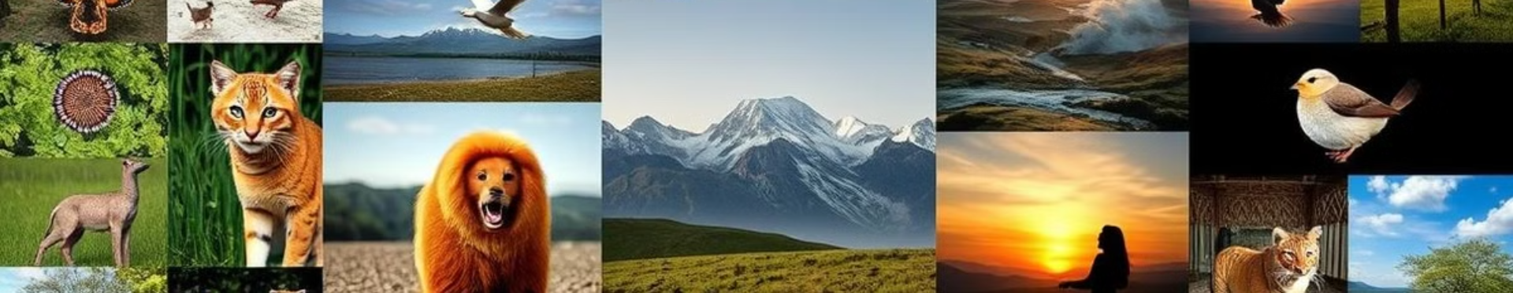
Feature Extraction and Export
The code extracts features from each image in the dataset using the ResNet50 model and saves these features as embeddings in a serialized format. These embeddings are stored in a file called embeddings.pkl, while the filenames are stored in filenames.pkl using the pickle library. Exporting these features prevents the need to repeatedly recompute them, which saves time and computational resources

Slide 6
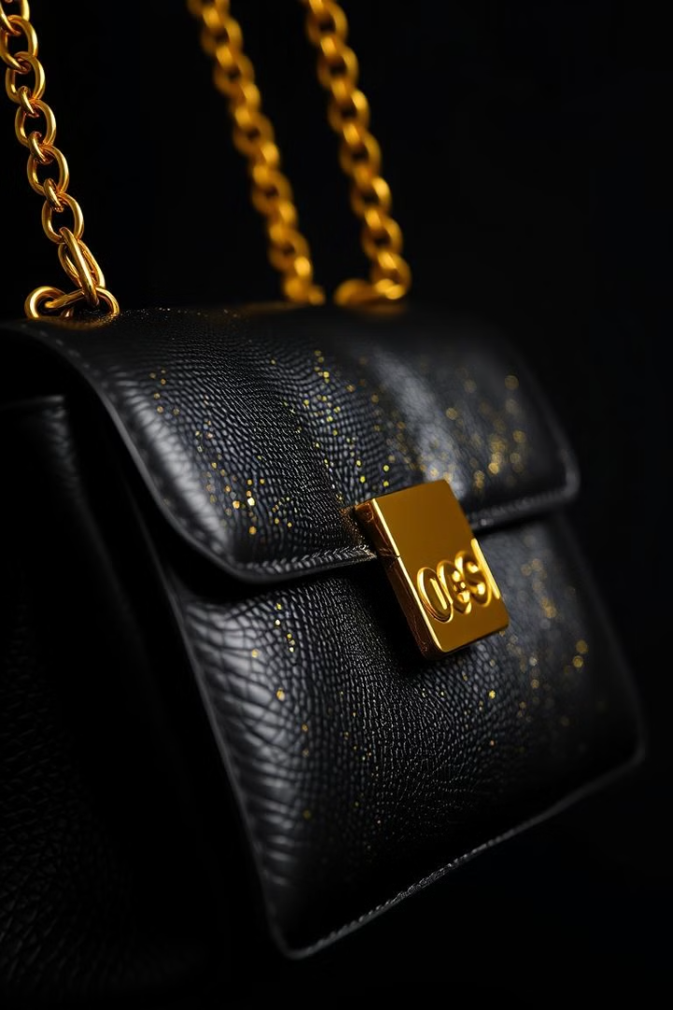



Extracting Features from Fashion Images
Input Image
Fashion items are fed into the pre-trained ResNet50 model.
Feature Extraction
The model's deep layers generate a compact, semantic feature vector representation.
Embedded Representation
The extracted features are used to position each fashion item in a high-dimensional feature space.

Slide 7
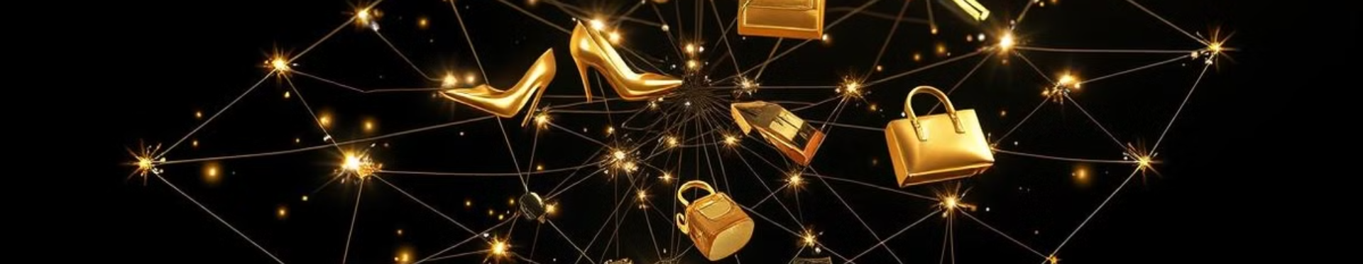



Similarity-based Recommendations
Query Item
Nearest Neighbors
Recommendations
A user selects a fashion item they're interested in.
The system finds the closest items in the feature space.
Similar fashion items are presented to the user as recommendations.

Slide 8
Generate Fashion Recommendation using KNN
Euclidean Distance and k-Nearest Neighbor: By normalizing the extracted features and using a NearestNeighbors model with Euclidean distance, the system finds visually similar items based on proximity in the feature space.

Slide 9
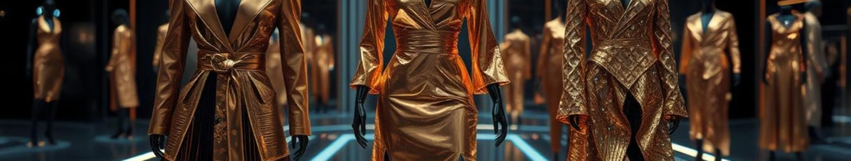
Challenges and Future Directions
Challenges
Future Directions
Handling Evolving Trends
Continual Learning for Dynamic Fashion
Cross-Modal Recommendations
Integrating Text, Images, and User Data
Explainable Recommendations
Transparent AI for Better User Trust

Slide 10
Name - Ishika
Enrollment no. - E23CSEU1723
Submitted to - Dr. Nitin Arvind Shelke

